Slide 1
PYTHON FOR DATA SCIENCE
(3150713)

Slide 2
Decision tree based tourism recommendation system

Slide 3
INTRODUCTION
PROJECT TITLE :- Decision tree based tourism recommendation system
NAME :- DHARTI PATEL
ENROLLMENT NO :- 200050131079
NAME :- SNEHA DAS
ENROLLMENT NO. :- 200050131085
BRANCH :- COMPUTER SCIENCE AND ENGINEERING
DIVISION :- 2

Slide 4
DESCRIPTION OF PROJECT
.
A Decision Tree is a Flow Chart, and can help you make decisions based on previous experience.
In this Decision tree based tourism recommendation system in which you can predict the tour worthy location of your liking from ratings of the places from the people who visited previously.
In this system we are going to apply 2 algorithms :-
Decision Tree
K means
The dataset we referred to do this project :-
- https://www.kaggle.com/datasets/ritvik1909/indian-places-to-visit-reviews-data

Slide 5
ABOUT THE DATA SET :-
As for the data set for the topic we chose is tour.csv.
we modified dataset by cleaning the unnecessary data and maintained the attributes: city place, rating
And we added experience , target . We have a target column which maps with the rating and experience and builds the decision tree.
we split the data in 20-80%, where 20% data for training and 80% data is for testing using this train and test data we figured the accuracy for prediction of our data.

Slide 6





LIBRARIES USED :-
Numpy
Pandas
Matplotlib
Seaborn
SkLearn

Slide 7
ALGORITHM USED :-
DECISION TREE :-
A decision tree is a non-parametric supervised learning algorithm, which is utilized for both classification and regression tasks. It has a hierarchical, tree structure, which consists of a root node, branches, internal nodes and leaf nodes.
K MEANS :-
K-means is an unsupervised learning method for clustering data points. The algorithm iteratively divides data points into K clusters by minimizing the variance in each cluster.

Slide 8
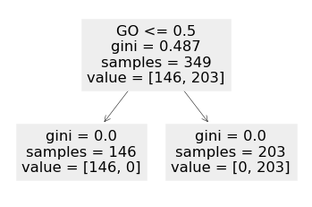
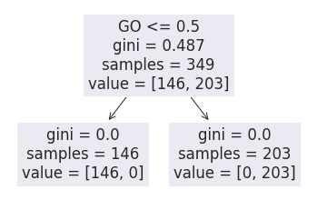
THING ANALYZED FROM DATA SET :-
We analyzed the datasets using various Python libraries and found the found the features which are most likely to affect the results of the dataset.
For eg.:-

Slide 9
PREDICTION :-
We predicted the models on y_test and worked towards improving the accuracy of the models.
We will show you how to estimate the best value for K using the elbow method, then use K-means clustering to group the data points into clusters.

Slide 10
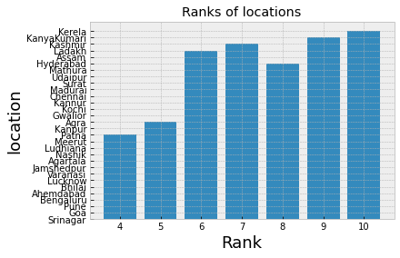
Ranks of location

Slide 11
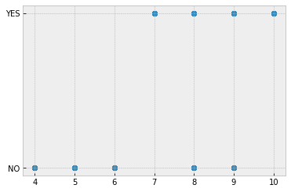
Prediction:-

Slide 12
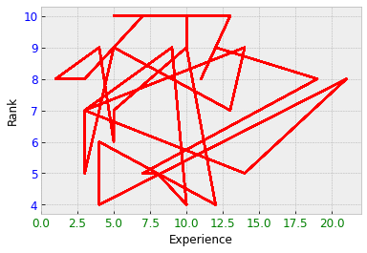
Rank vs experience :-

Slide 13
Thank you

